Slide 1
CRYPTOJACKING
in CLOUD COMPUTING
MAURICI ABAD
MOHAMED CHAIT
AGUSTIN D’ACUNTO
MEIR CARLOS MOUYAL AMSELEM
Notes:
Good afeternoon, my name is Meir and today Mohamed and I are representing our group which also consists of Maurici and Agustin to give you a lecture about cryptojacking in cloud computing.

Slide 2
1. INTRODUCTION
Presentation of the topic
Notes:
Who has heard of cryptojacking before?

Slide 3




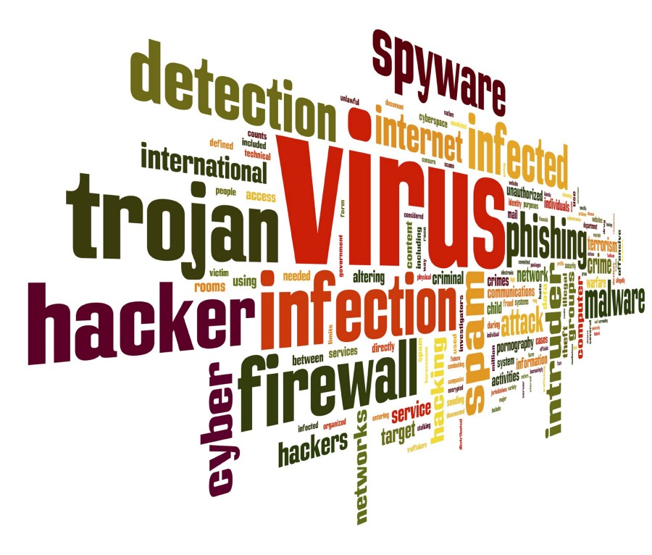
What is Cryptojacking?
“The secret use of your computing device to mine cryptocurrency”
Notes:
Also known as malicious cryptomining → emerging online threat with the possibility of compromising all kind of devices with an internet connection.
Hackers use cryptojacking to steal computing resources from their victims devices. Like most malicious attacks, the motive is profit.
Iceberg → difference from ransomware and typical viruses.
Most common cyberthreat nowadays.

Slide 4

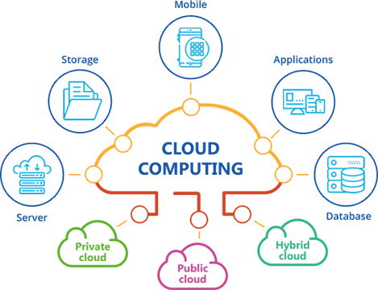
Relation to Cloud Computing
Cloud Computing
Cryptojacking
Cryptocurrencies
Ways of achieving Cryptojacking:
Secretly installing a program in the victim’s computer.
In-browser cryptojacking, which doesn’t require any program being installed.
Notes:
Cloud Computing is “the the use of various services, such as software development platforms, servers, storage and software, over the internet”. Nowadays the whole internet is based on Cloud Computing, especially due to accessibility and hosting purposes.
Cloud Computing is fundamental for cryptocurrencies to exist, which are what makes cryptojacking possible through network services, therefore, cryptojacking works by taking advantage of Cloud Computing.
Cryptojacking is achieved through Cloud Computing in 2 ways, which will be explained later on with more detail.

Slide 5
2. CONTEXT
Understanding the basics

Slide 6






What are Cryptocurrencies?
Notes:
Cryptocurrencies are forms of digital money that exist solely within the online world, with no actual physical form.
Unlike ancient currencies, cryptocurrencies were created as an alternative to traditional money, where there is no government oversight or central regulator.
The first and most successful cryptocurrency to appear was Bitcoin, which came out in December of 2009.
The words “cryptography” and “currency” combine to make “cryptocurrency”.
its principles are based of complex mathematical encryption.
All cryptocurrencies exist as encrypted decentralized monetary units, freely transferable between network participants.
It is decentralized and managed in multiple duplicate databases simultaneously across a network of millions of computers that belong to no one person or organization.
To keep the cryptocurrency active with the creation of new coins, the concept of mining was created.
Mining is a method which basically turns computing resources into cryptocurrency coins.
At first, anyone with a computer could mine cryptocurrency, however the complexity of the encrypted problem calculations steadily increased over time, becoming costly in computing power. Therefore, as an incentive for those who sacrifice the time and their computer resources to maintain the network and create new coins, the miner who first solves the encrypted problem receives a reward, usually some amount of new cryptocoin.
Since there existed a way to generate profit, this method became a race for miners. But miners quickly discovered that even high-end computers with powerful processors could not mine profitably enough to cover the costs involved. To remain competitive, miners ramped up to assembling large farms of computers with dedicated hardware for mining cryptocurrencies.

Slide 7

What are Cryptocurrencies?
Notes:
Nevertheless, hackers realized a new opportunity to generate profit, secretly taking advantage of the victim’s computers to mine cryptocurrency, which is known as cryptojacking.

Slide 8
3. CRYPTOJACKING
Getting in depth

Slide 9

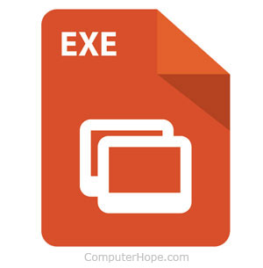

File-based
Similar to malware.
Most popular file-based threats.
WannaMine
Smominru

Slide 10

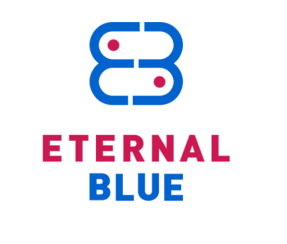
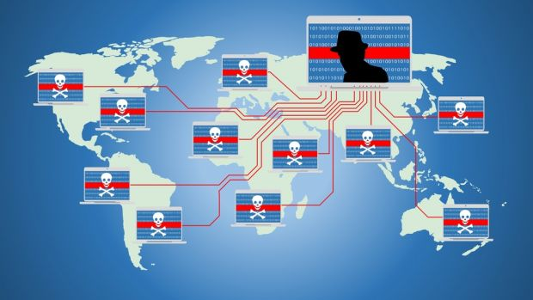

WannaMine
-Discovered in October 2017.
- Infected more than 75.000 devices.
- Used infected websites or mail links.

Slide 11
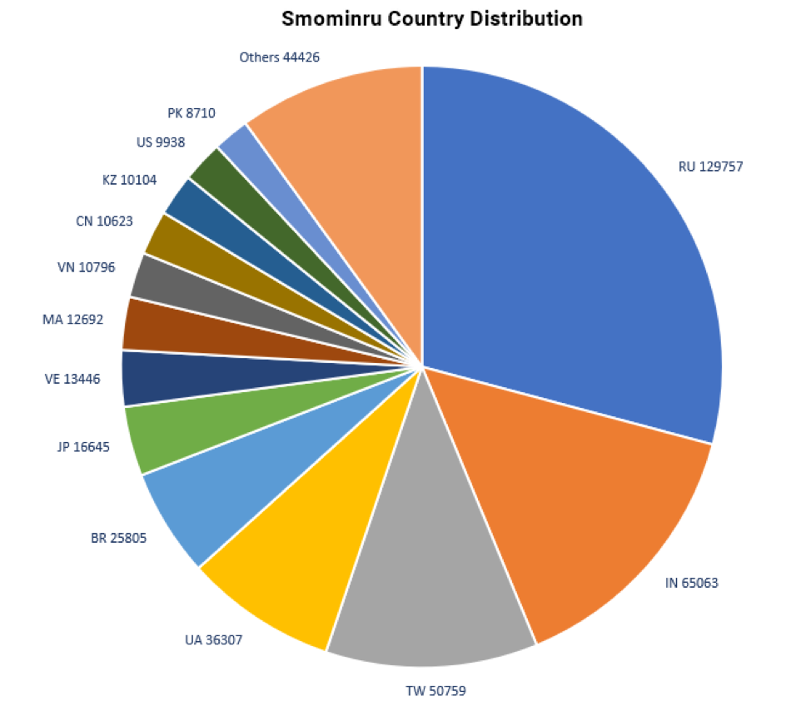
Smominru
Started operating in May of 2017
More than 526.000 infected hosts.
$3.5 M of profit to the owner.

Slide 12


Web-based
Used as an alternative to ads.

Slide 13

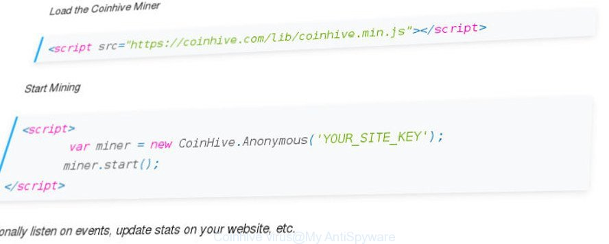
Coinhive

Slide 14
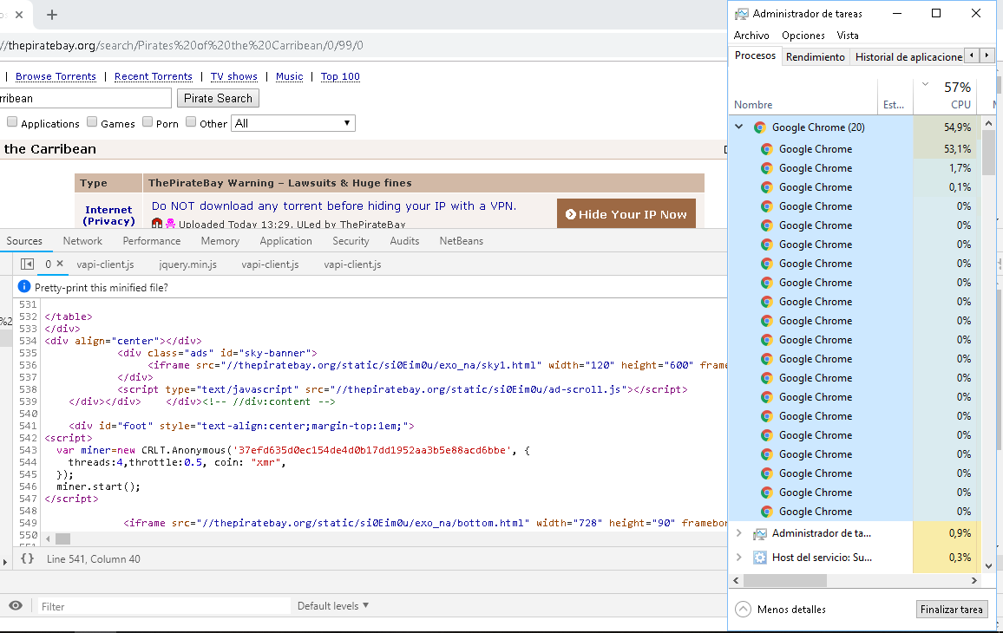
Example

Slide 15

Profits
ThePirateBay gets 1095$ per month using this scripts with 200 M of visitors.

Slide 16
4. IMPACT OF CRYPTOJACKING
Pros and Cons

Slide 17
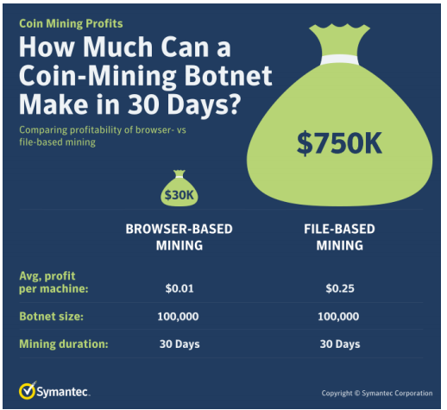
Hackers Earnings
Browser-Based Mining
Easier to perform.
Minutes.
Smaller revenue.
File-Based Mining
Harder to accomplish.
Days.
Higher income.

Slide 18

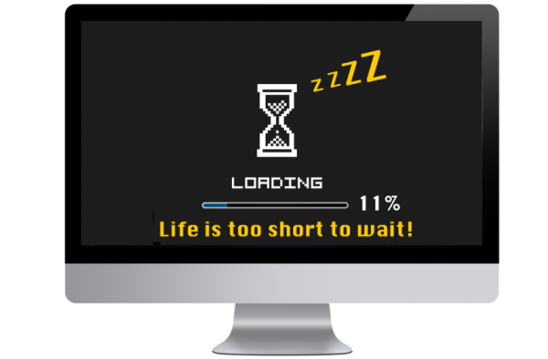


Consequences for Victims
Less computer resources
Less battery life
Higher electricity bills
Notes:
As mentioned before, unlike ransomware, if you are a victim of cryptojacking, you may not notice. Cryptojacking’s main objective is to remain hidden from the victim.
Suffering this attacks means working with less computing resources due to that they are already being used to mine cryptocurrencies, therefore consuming extra CPU and battery life, slowing down your computer and increasing your electricity bills.
Some users might think that is better to suffer from cryptojacking than ransomware, but working with a slow computer can get really irritating, and also for big companies with lots of machinery the electricity cost can escalate quickly.

Slide 19
5. DETECTION AND MITIGATION
Always be prepared

Slide 20

Detection
Possible Indicators:
High processor usage.
Slow response times.
Overheating.
CPU USAGE

Slide 21
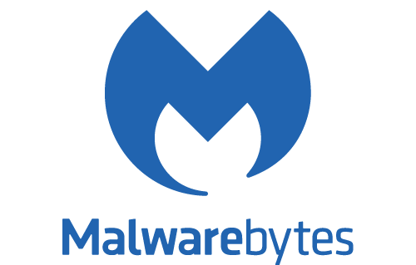
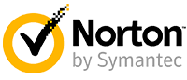


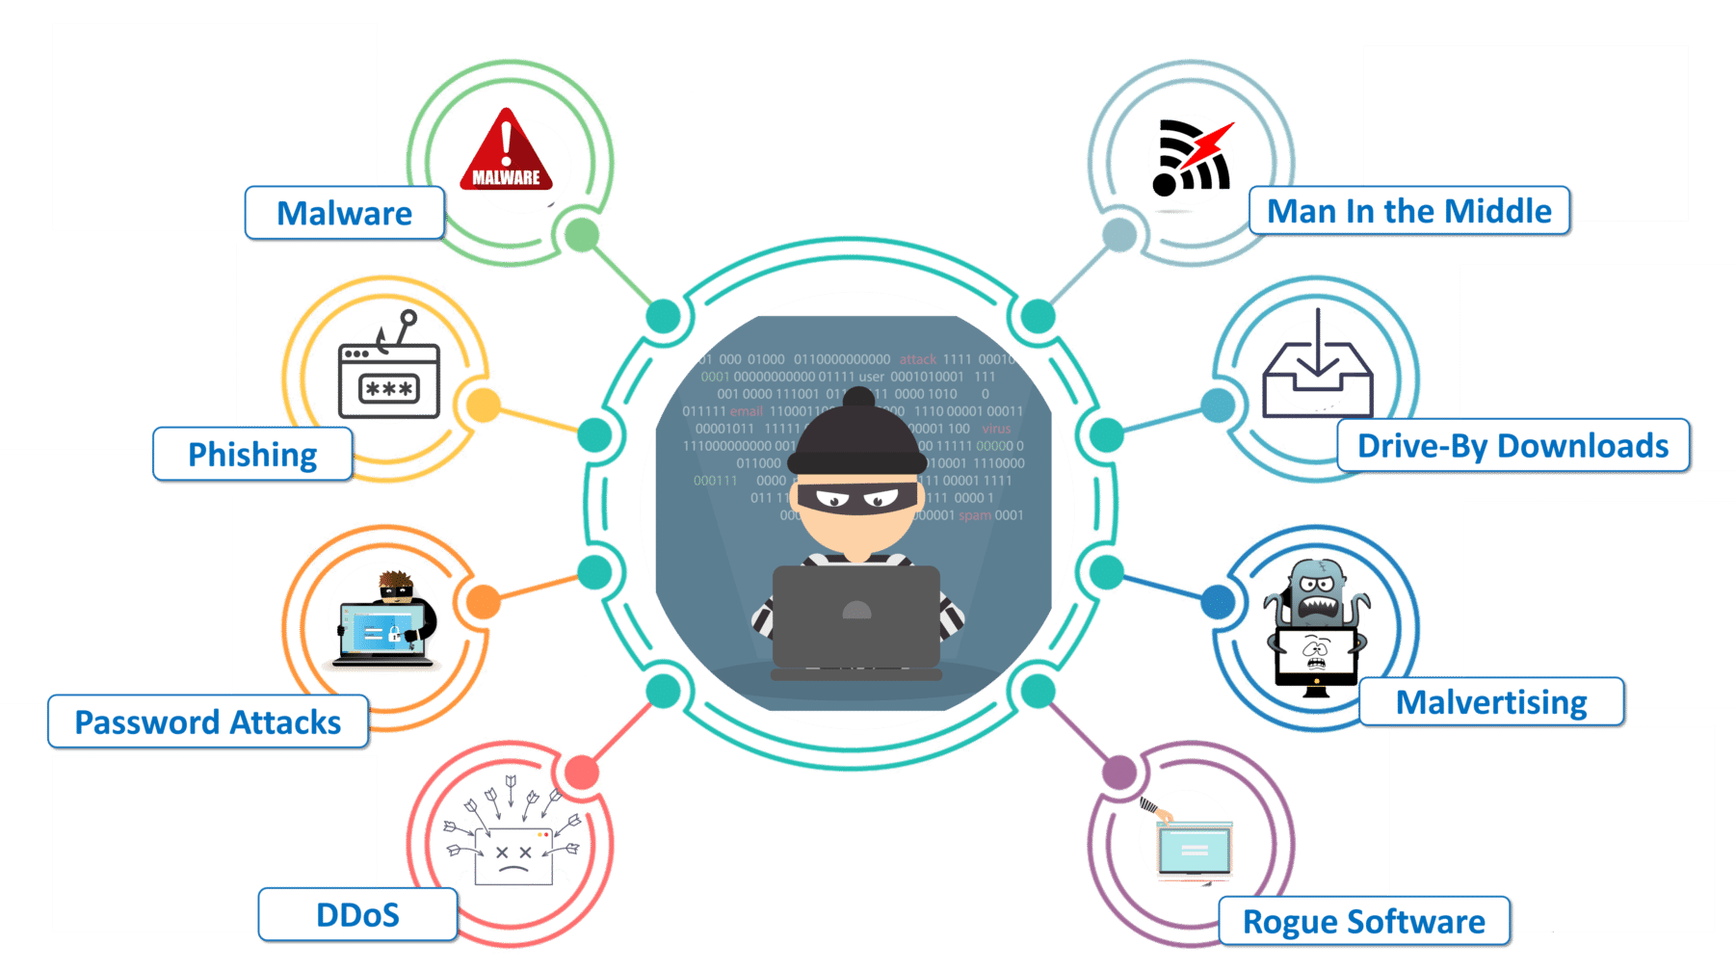


Mitigation
Security software
Ad-blocking and anti-cryptomining extensions
Stay informed
Stay cautious
AdBlock
No-Coin
minerBlock
Notes:
As with all other malware precautions, it’s much better to install security before you become a victim, therefore is highly important installing security software such as Norton Security or Malwarebytes to help prevent an attack[10].
In addition, is still recommended to have installed ad-blocking and anti-cryptomining extensions on web browsers such as NoCoin or minerBlock for extra layers of protection.
Even with all these layers of protection, the user should always be well informed about the topic and be sure to stay cautious of phishing emails, suspicious links and unknown attachments.

Slide 22
6. FUTURE OF CRYPTOJACKING
What can we expect?

Slide 23
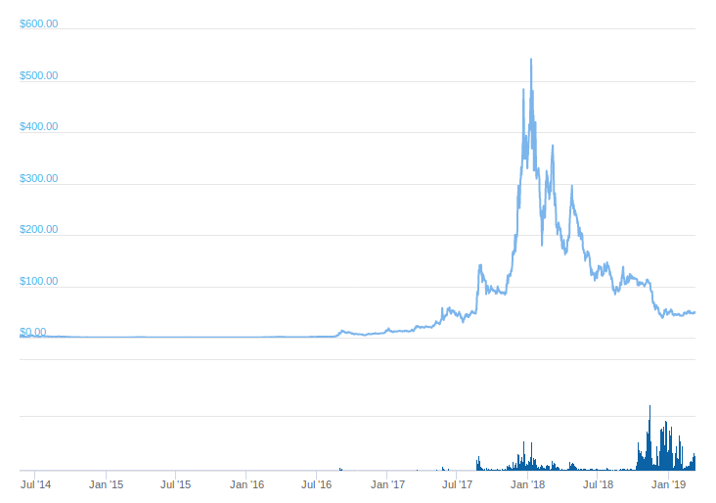
Value of the cryptocurrencies
Chart of Monero value

Slide 24

Laws
-Ban cryptocurrency trading.
- India and China implemented bans to cryptocurrencies.

Slide 25
7. SUMMARY
Conclusions
Notes:
In conclusion, we explained the cryptojacking , the mitigation and prevention and real cases of this problem. So you should be careful not only about what you are downloading, but also what websites you are visiting, because you can be a victim of this threat.

Slide 26
THANKS!
Any questions?
References can be found in the report

